Slide 1
Precise, Dynamic Information Flow for Database-Backed Applications
Jean Yang, Travis Hance, Thomas H. Austin, Armando Solar-Lezama, Cormac Flanagan, and Stephen Chong
PLDI 2016
Notes:
Hi everyone.
Now we’re going to talk about how to prevent information leaks in database-backed applications.
TRANSITION: To give some context, let’s talk about another kind of leak.

Slide 2

An oil skimming operation works in a heavy oil slick after the spill on April 1, 1989. (Photo from Huffington Post)
Notes:
Some of you might remember this photo from 1989. The Exxon Valdez tanker struck ground and spilled 30 million gallons of crude oil.
TRANSITION: This was one of the biggest ecological disasters of the century.

Slide 3

Oil-covered otter. (Photo from the Human Impact Project)
Notes:
The otters became covered in oil.
TRANSITION: A major factor was the fact that there was only one layer of steel between the sea and the crude oil the Valdez was carrying.

Slide 4
The Relationship Between Design and Accidents
Single hull
Double hull
Crude oil
Crude oil
Required by the Oil Pollution Act of 1990.
Notes:
Afterward, new standards were released as part of the Oil Pollution Act of 1990 that required all tankers to have double hulls, a set of compartments to hold air or ballast water between the outer hull of a ship and the cargo-carrying tanks.
Double hulls not only make it much harder for a ship to sink if the outer hull is breached, but they have prevented countless oil spills.
The main takeaway is that accidents happen and we should account for them at the design stage.
TRANSITION: Now you might be wondering: what does all this have to do with information leaks?

Slide 5
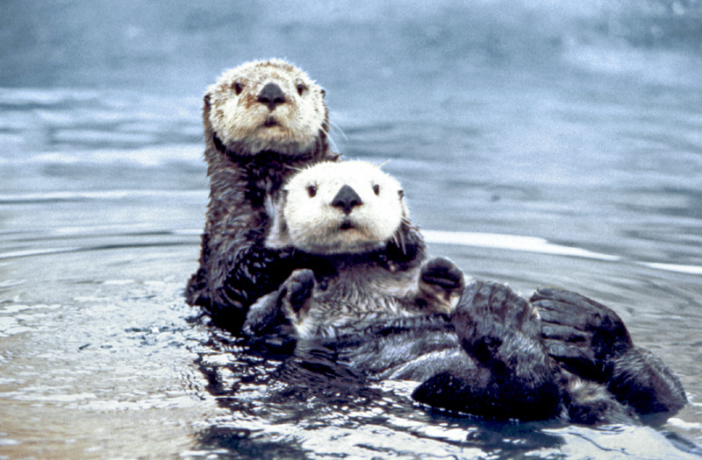
But what about information leaks?
Notes:
TRANSITION: Information leaks are also becoming quite catastrophic, to the point where even the otters are sad.

Slide 6
Wanted: Double Hull for Information Security
Single hull
Double hull
Sensitive data
Sensitive data
Research in language-based security looks at designs for double hulls [Sabelfeld and Myers, JSAC 2003].
Our goal: make double hulls that are as easy to construct as possible!
Notes:
What we want is the double hull equivalent for information security.
But information leaks are more complicated: what it means to “strike ground” depends on the viewer and computation.
TRANSITION: The good news is that it means we’re not out of a job.

Slide 7
This Talk: Making It Easier to Secure Web Programs
Why it’s hard to prevent information leaks.
A programming model that makes writing secure web programs easier.
How we support that programming model in database-backed applications.
Notes:
TRANSITION: Let’s start by going through an example.

Slide 8
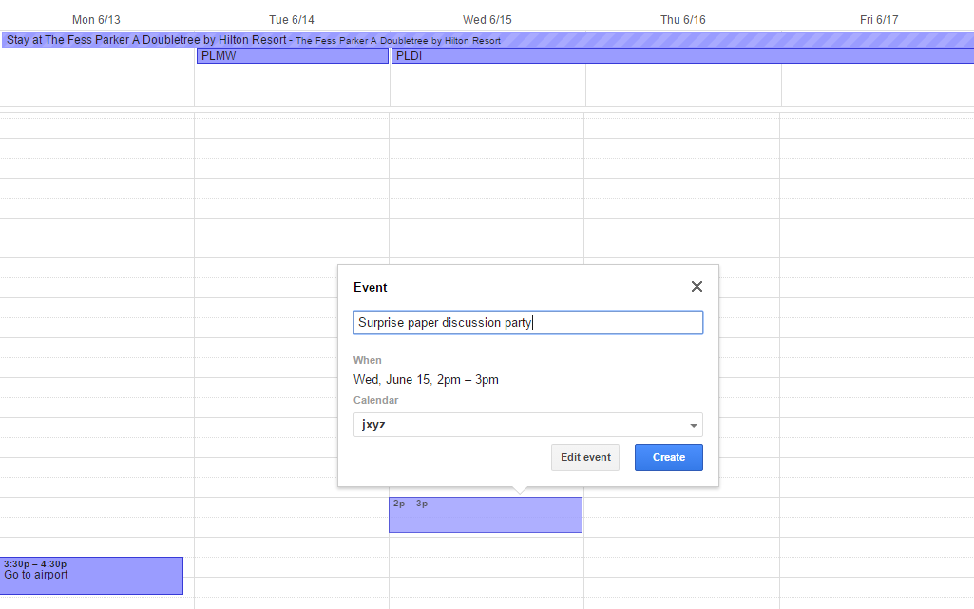





Social Calendar Example
Let’s say Arjun and I want to throw a surprise paper discussion party for Emery.
Notes:
Suppose we have a social calendar like Google Calendar, but with more sharing and searching features.
Let’s say Arjun and I want to throw a surprise paper discussion party for Emery to thank him for being program chair. As members of the PC, we learned that he likes discussing papers quite a bit.
TRANSITION: Now I’ll explain how even seemingly simple policies have subtle interactions that the programmer can easily get wrong.

Slide 9






Challenge: Different Viewers Should See Different Events
Surprise discussion for Emery at Chuck E. Cheese.
Pizza with Arjun/Jean.
Guests
Emery
Private event at Chuck E. Cheese.
Strangers
Notes:
Different users of the social calendar should see different versions of the event information.
Guests should see that there is a surprise paper discussion for Emery and that it happens to be at Chuck E. Cheese’s. For those of you who are unfamiliar, Chuck E. Cheese’s is a popular party location for children that has games and also serves pizza for birthday parties. Clearly Arjun and I don’t know the Santa Barbara area very well.
Emery should see simply that he has pizza plans with Arjun and me.
Everybody else, including the otters who are celebrating not being covered in oil, should see that there is a private event at Chuck E. Cheese. The venue is, after all, public—and the otters should be informed they shouldn’t try going there are the time.
Let’s suppose the social calendar supports an additional policy on guest lists, that they may be visible only to hosts until they are finalized. Since the policy for who can see party details depends on the guest list, that policy now depends on another policy!
TRANSITION: Let’s take a closer look at how these policies interact.

Slide 10
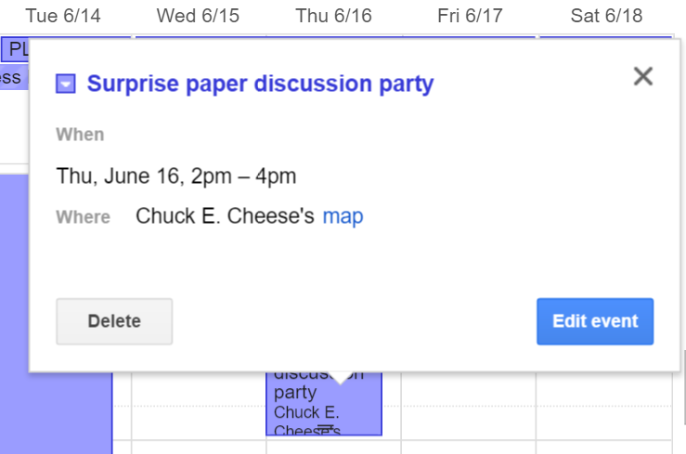

Policies May Depend on Sensitive Values
Must be on guest list.
Leaky enforcement: when the programmer neglects dependencies of policies on sensitive values.
Policy for event depends on policy for guest list!
Guest List
Finalized list
Must be member of list and the list must be finalized.
Notes:
If you’ve shared a calendar with friends or colleagues or an organization, you’ve probably had the experience of events showing up on your calendar.
What we’d like is for the surprise paper discussion party to show up only on the calendars of people who are allowed to see. But now I’ll describe why this isn’t as easy as one might first think.
The event has a policy that you be on the guest list to see the event information.
The guest list has its own policy that you must be a member of the list and the list must be finalized.
Potential guests shouldn’t be able to see event information until the event is finalized.
An easy mistake, however, is to neglect the connection between the two policies. I call this “leaky enforcement,” because it allows the system to show event information to potential guests who don’t end up being invited.
TRANSITION: To better illustrate the point, here is a story of what happens when the programmer doesn’t take this dependency into account.

Slide 11



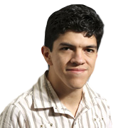

A Story of Leaky Enforcement
We add Armando to non-final guest list.
Armando figures out he was uninvited.
1
4
Guest List
Finalized list
There was a party on my calendar…
Armando sees the event on his calendar.
We run out of space and remove Armando.
2
3
Guest List
Finalized list
Notes:
First, we add my PhD advisor Armando to the guest list.
Armando sees the event on his calendar. Since he does a lot of meeting scheduling by allowing people to sign up on his calendar, he plans to go to the event.
We then somehow run out of space and we have to remove Armando from the finalized list.
Armando looks on his calendar and figures out that he might have been uninvited, as the party no longer shows up on his calendar. Something even more awkward that could happen is that Armando shows up to the party anyway, and we have to tell him he was uninvited.
TRANSITION: What happened here?

Slide 12

A Story of Leaky Enforcement
We add Armando to non-final guest list.
Armando figures out he was uninvited.
1
4
Problem: implementation for event policy neglected to take into account guest list policy.
Guest List
Finalized list
There was a party on my calendar…
This arises whenever we trust programmers to get policy checks right!
Armando sees the event on his calendar.
We run out of space and remove Armando.
2
3
Guest List
Finalized list
Notes:
First, we add my PhD advisor Armando to the guest list.
Armando sees the event on his calendar. Since he does a lot of meeting scheduling by allowing people to sign up on his calendar, he plans to go to the event.
We then somehow run out of space and we have to remove Armando from the finalized list.
Armando looks on his calendar and figures out that he might have been uninvited, as the party no longer shows up on his calendar. Something even more awkward that could happen is that Armando shows up to the party anyway, and we have to tell him he was uninvited.
TRANSITION: What happened here?

Slide 13




Need to Track Policies and Viewers Across the Code
“What is the most popular location among friends 7pm Tuesday?”
Update to all calendar users
Need to track how information flows through derived values and where derived values flow!
Notes:
Sensitive values aren’t just being shown directly, but also through various searching and aggregation features.
The social calendar might, for instance, support a search like “What is the most popular location among my friends 7pm Tuesday?” Only those with the appropriate permissions should be able to see that the real answer is Chuck E. Cheese.
Things get even more complicated as data is being broadcast to lots of different users, each with their own permissions, rather than being shown to one user at a time.
Now the programmer needs to track not just how information needs to flow through derived values, but also where these derived values are flowing.
TRANSITION: Bugs often occur because of the policy spaghetti that arises.

Slide 14
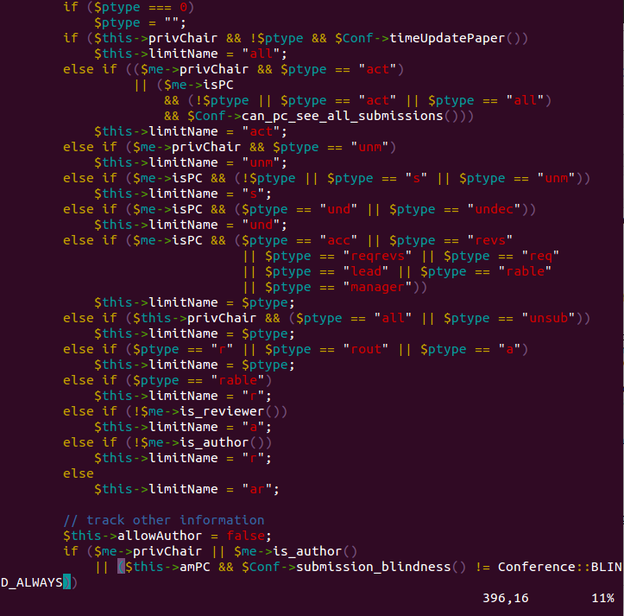
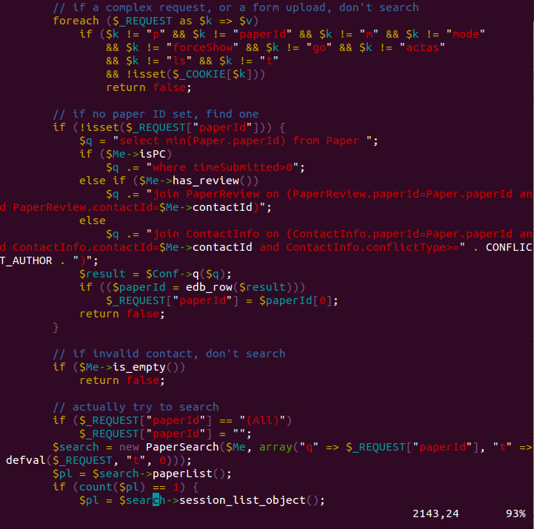
“Policy Spaghetti” in HotCRP
Conditional permissions checks everywhere!
Notes:
Here are a couple of screen shots of code from the HotCRP conference management system, a system people often cite not only because it’s one of the few open source software projects many academics are familiar with, but also because it’s full of complex policy interactions.
I don’t expect you to read the code, but what I do want to show are the highlighted conditional permissions checks all over the code. What I’ve highlighted are if and else statements that affect what is displayed, what functions are called, and even what SQL queries are issued based on properties of the viewer and the current situation.
TRANSITION: Before this talk, you might have thought leaks were a developer education problem.

Slide 15
Jacqueline Web Framework to the Rescue!
1
Programmer specifies information flow policies separately from other functionality.
3
Enhanced runtime encompasses applications and databases, preventing leaks between the two.
Policy annotations
Sensitive data
Database
2
Runtime prevents information leaks according to policy annotations.
Notes:
In this talk, I describe the Jacqueline web framework, the double hull for database-backed web applications.
In Jacqueline, programmers provide policy annotations separately from the rest of the program. This is what we call a policy-agnostic programming model because the policies are factored out.
The runtime prevents information leaks according to policy annotations.
And the enhanced runtime encompasses both the application and the database, preventing leaks between the two. I’ll describe later in the talk why it’s especially important to enforce policies across these multiple runtimes.
TRANSITION: With this paper, we make the following contributions.

Slide 16
Contributions
Policy-agnostic programming model for database-backed web applications.
Semantics and proofs for policy-agnostic programming that encompasses SQL databases.
Demonstration of practical feasibility with Python implementation and application case studies.
Notes:
TRANSITION: Let’s start by looking a the programming model for the Jacqueline web framework.

Slide 17

Jacqueline Web Framework
Object-relational mapping propagates policies and sensitive values through computations.
Policies
Framework shows appropriate values based on viewer and policies.
Enhanced runtime
Framework attaches policies based on annotations.
Notes:
The design of Jacqueline is based on a standard model-view-controller web framework where the model describes the data layout, the view describes the frontend, and the controller describes everything in between.
In these frameworks, there is an object-relational mapping that provides a uniform representation of the data, allowing the controller to manipulate database items as runtime objects.
In Jacqueline, the programmer additionally provide annotations alongside the model about information flow policies. The controller runs in an enhanced runtime. The framework is responsible for attaching policies based on annotations, propagating policies across application code and database queries, and defaceting based on the viewer.
The framework relies on the object-relational mapping and the enhanced runtime to ensure policy enforcement across the application and database.
TRANSITION: Here is what it looks like to program using Jacqueline.

Slide 18
Coding in Jacqueline
class Event(JacquelineModel):
name = CharField(max_length=256)
location = CharField(max_length=512)
time = DateTimeField()
description = CharField(max_length)=1024)
Base schema
@jacqueline
def has_host(self, host):
return EventHost.objects.get(
event=self, host=host) != None
@jacqueline
def has_guest(self, guest):
return EventGuest.objects.get(
event=self, host=host) != None
Policy helper functions
Information flow policy for location field
@staticmethod
@label_for(‘location’)
def restrict_event(event, ctxt):
return event.has_host(ctxt) or event.has_guest(ctxt)
Public value for location field
@staticmethod
def jacqueline_get_private_location(event):
return “Undisclosed location”
Notes:
We’ve implemented Jacqueline as an extension to the Django Python web framework and we’ve made programming in Jacqueline look as much like programming in Django as possible.
In both Jacqueline and Django, the programmer describes data schemas corresponding to how to lay out the data.
On top I show the data schema for describing Jacqueline fields. We define the name, location, time, and description fields for an event, as well as the “visibility” field where the user can specify whether an event is visible to everyone or only guests. The fields of the event are the secret values by default.
The programmer can designate a field as sensitive by providing an alternate, public value. Here we show the public value for any “location” field is “undisclosed location.” Functions to compute the public value take the current row as an arugment.
To specify when the actual location is to be shown versus this public value, the programmer can declare a policy. The policy takes as arguments the current row and an output context. Here, our policy says that if the event visibility is “guests only,” then the secret location field can be shown if the viewer is a host or a guest.
Whether the viewer is a host or guest is computed using regular database queries. The system enforces the policies throughout these queries so the programmer can be sure that they do not leak information!
TRANSITION: These annotations are all the programmer needs to provide in order to implement information flow policies.

Slide 19
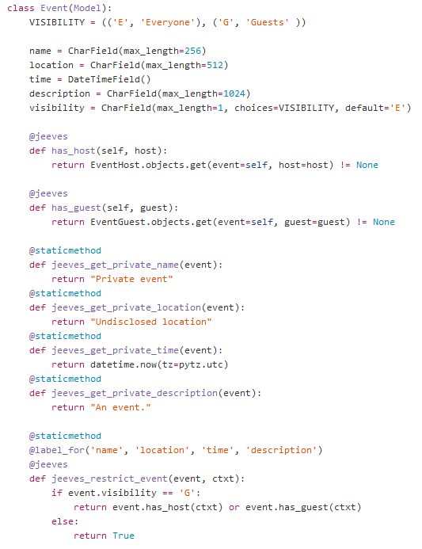
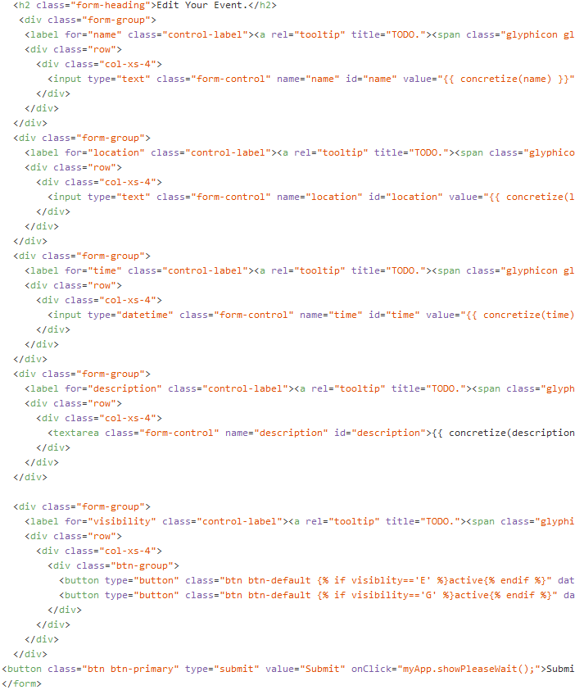
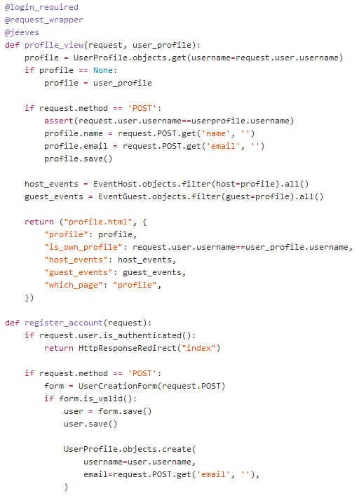
Centralized Policies in Jacqueline
Model
View
Controller
Centralized policies! No checks or declassifications needed anywhere else!
Notes:
Here are some screen shots of the implementation of the calendar example in Jacqueline.
Again, I don’t expect you to read the code, but what I want to show you is that there are centralized policies, the rest of the program may be agnostic to the policies, and the runtime is responsible for differentiating program behavior.
TRANSITION: To understand how Jacqueline works, let’s look at what is going on in the enhanced runtime.

Slide 20

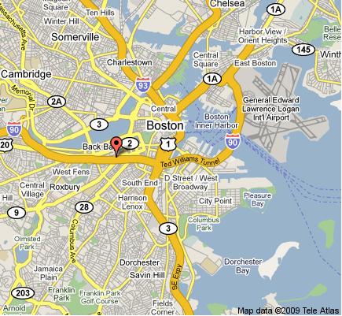



Closer Look at the Policy-Agnostic Runtime
Jeeves [Yang et al 2012, Austin et al 2013] uses facets [Austin et al 2012] to simulate simultaneous multiple executions.
userCount = 0
Runtime propagates values and policies.
1
Runtime solves for values to show based on policies and viewer.
2
if == :
userCount += 1
return userCount
print { }
print { }
1
0
Notes:
Jacqueline uses for its application runtime the policy-agnostic Jeeves language.
Jeeves has an execution model that simulates simultaneous multiple executions on different facets of sensitive values.
In Jeeves, sensitive values are faceted and can take on multiple values depending on the viewer and policies.
The runtime propagates values and policies and solves for values to show based on the policies and the viewer.
I picked this snippet of code to illustrate implicit flows. Here we are setting a variable x to zero and incrementing it if the sensitive location value is equal to Chuck E Cheese. Even if the location doesn’t leak directly, the programmer can infer its value by examining x.
TRANSITION: The runtime tracks values through all computations, preventing implicit flows.

Slide 21
Labels Track Sensitive Values to Prevent Leaks
guest
Labels follow values through all computations, including conditionals and assignments.
if == :
c += 1
guest
true
false
if :
c += 1
Emery can’t see secret party information or results of computations on those values!
guest
c_{old}+1
c_{old}
c =
Notes:
The runtime uses labels to map sensitive values to policies.
All values computed from sensitive values are associated with their labels. All assignments occurring under conditional branches are associated with the labels corresponding to assumptions that were made to enter that branch.
More subtly, labels also help account for when policies depend on sensitive values, even the values that they themselves are protecting.
With labels to do the bookkeeping, all values computed from sensitive values are shown only according to the policies.
TRANSITION: This is all great, but in order to be able to use this for practical web applications we need to solve the database problem.

Slide 22


Slide 23


Slide 24



The Dangers of Interacting with Vanilla Databases
Application
Database
Database queries can leak information!
Queries
select * from Users where location =
Application
All data
Database
Impractical and potentially slow!
select * from Users
Challenge: Support faceted execution when interacting with an unmodified SQL database.
Need faceted queries!
Notes:
Web applications often leak information by revealing the results of arbitrary database queries, for instance through a search interface. It doesn’t matter how much policies are enforced in the application if a single query can subvert our guarantees. Thus we don’t want to just use a vanilla SQL database directly.
One way to take advantage of language-based solutions like Jeeves is to load all the data into the application and use the enforcement there. This is what you’d typically have to do with a language-based approach, as they often assume a single runtime. The issue is that doing all the work in the application is slow and we often can’t load the database into memory.
The challenge is to support this faceted execution model when interacting with unmodified SQL databases.
What we want is faceted queries!
TRANSITION: Here are the semantics we want for faceted queries.

Slide 25
Semantics of a Faceted Database
SQL Database
select * from Users where location =
save( )
Store facets as strings?
Conceptual row
Primary key | Location
1
New database for each label?
Too expensive! Too difficult to extend the formal semantics!
Notes:
What we want is to be able to save faceted values to the database and then run faceted queries on these values the same way we compute using faceted values in the Jeeves runtime.
Some naïve approaches to encoding facets using SQL databases involve storing facets opaquely as strings and storing different databases for each label.
But these approaches are expensive for different reasons and also make it difficult to extend the formal guarantees of faceted execution that we worked so hard to develop.
TRANSITION: It turns out that we can encode facets in a way that both allows us to leverage SQL implementations and the existing formal machinery.

Slide 26
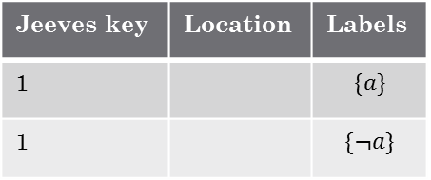
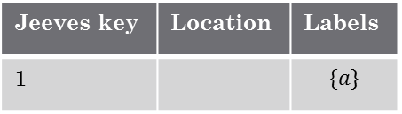
Solution: Use ORM to Map Facets onto Database Rows
Conceptual row
Jeeves key | Location | Labels
1 |  | $$\{a\}$$
1 |  | $$\{¬a\}$$
Primary key | Location
1
a
select * from Users where location =
Jeeves key | Location | Labels
1 |  | $$\{a\}$$
ORM refacets
a
Jeeves key | Location
1
NULL
Notes:
TODO: Insert slide about conceptually storing faceted rows
What we do is we use the object-relational mapping to map facets onto multiple database rows.
Object-relational mappings typically support a uniform data representation between the application and database and mediate a set of queries. We have developed a faceted object-relational mapping that supports a uniform facet representation and mediates policy-agnostic queries.
We do this by augmenting SQL tables with metadata to do facet bookkeeping to store multiple rows for a single faceted value.
Let’s say we have a faceted location value guarded by a label a.
We can store this as two rows in our database, connected to each other by a uniform Jeeves key, with the additional bookkeeping information that one of the rows corresponds to the positive a facet and the other one correspond to the not-a facet.
What’s great about this encoding is that it allows us to take advantage of existing SQL implementations for queries such as select.
When we select all columns from Users where the location is Chuck E Cheese’s, the database will only return the rows that match, but then the ORM will create facets so that these rows are only visible to permitted viewers.
TRANSITION: It turns out that this encoding of facets allows us to use existing SQL implementations for many standard queries.

Slide 27
Supporting Queries in Jacqueline
Jacqueline Supports | SQL Implements | ORM Implements
get | select | refaceting
all | select | refaceting
filter | select | refaceting
sort | order by | refaceting
foreign keys | join | -
save | delete, insert | turning a faceted value into multiple rows
delete | delete | keeping track of which facets to delete
Can use SQL implementations for many queries!
Notes:
Jacqueline supports getting records from the database, filtering records, sorting records, foreign key references into other tables, saving, and deleting.
The remarkable thing is that we can implement all of this database functionality simply by using the SQL implementations and then using the ORM to perform refaceting afterward.
Save and delete require some more bookkeeping to turn faceted rows into multiple rows and to keep track of which facets to delete, respectively.
Note that we currently have to perform aggregation in the Jeeves runtime, since using the database implementations alone doesn’t allow us to preserve faceted execution.
TRANSITION: You might wondering about why it’s not too expensive to do faceted execution for a web program.

Slide 28


Slide 29
Early Pruning Optimization
Policies
Observation:
Framework can often (but not always) track viewer.
Enhanced runtime
Optimization: Can often explore fewer possible paths!
Notes:
There’s a key insight about web programs that makes this possible.
The high level of the insight is this: in web programs, the framework can often keep track of the viewer.
This allows us to implement an optimization we call “Early Pruning” that allows us to throw away the irrelevant paths once we know the viewer.
Note that we can only do this for read-only parts of the code, but for web applications these are often the computationally intensive ones.
TRANSITION: In the paper we also have a formalization of the interaction between faceted execution and the database, as well as this optimization.

Slide 30

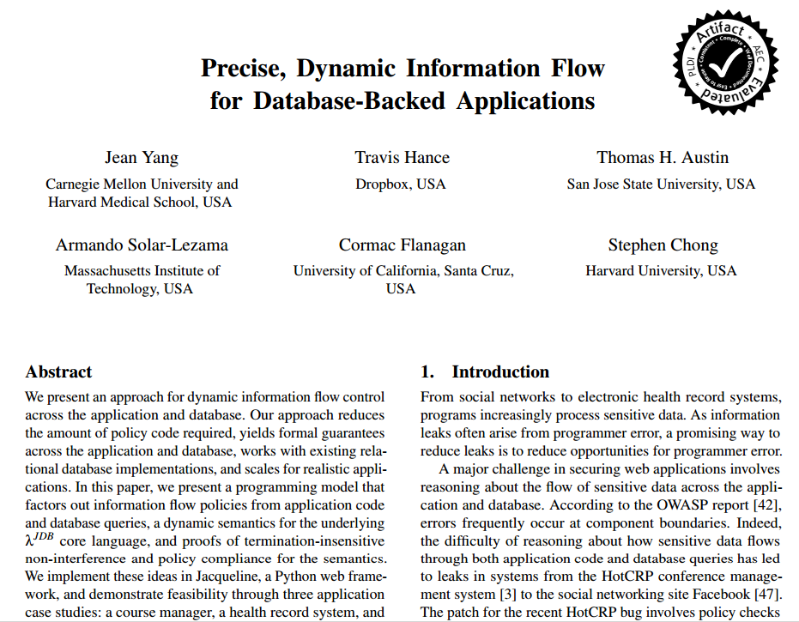
Notes:
TRANSITION: I won’t go into the details here, but I will describe at a high level our security guarantee.

Slide 31


Review: Traditional Non-Interference
Secret values should not affect public output.
guest
guest
if == :
if == :
userCount += 1
userCount += 1
guest
0
1
Challenge: Compute labels from program—may have dependencies on secret values!
print { }
0
Notes:
First, let’s do a quick review of traditional non-interference.
Non-interference is the property that secret values should not affect public output.
Traditional non-interference says that if the viewer can’t see the secret component of the location, then it shouldn’t matter if it’s Pizza Hut or Dominoes—the resulting output should be the same.
For policy-agnostic programming, the challenge is characterizing what non-interference means when the labels determining whether something is secret or public may themselves depend on sensitive values.
TRANSITION: We have developed non-interference and policy compliance theorems to capture the dependency.

Slide 32
Policy-Agnostic Non-Interference
guest
guest
if == :
if == :
userCount += 1
userCount += 1
guest
0
1
Theorem:
All executions where guest must be public produce equivalent outputs.
print { }
0
Can’t tell apart secret values that require guest to be public.
Notes:
Our policy compliance theorem says that all executions where a must be public produce equivalent outputs. The insight is that the viewer shouldn’t be able to tell apart the secret values that require a label to be public.
If the viewer can’t see the guest list because they’re not on it, they shouldn’t be able to tell the secret guest list from any other guest list they’re not on.
We’ve proven that this property holds across the application code and database queries.
TRANSITION: To make sure that our claims hold for realistic applications, we built the following application case studies.

Slide 33
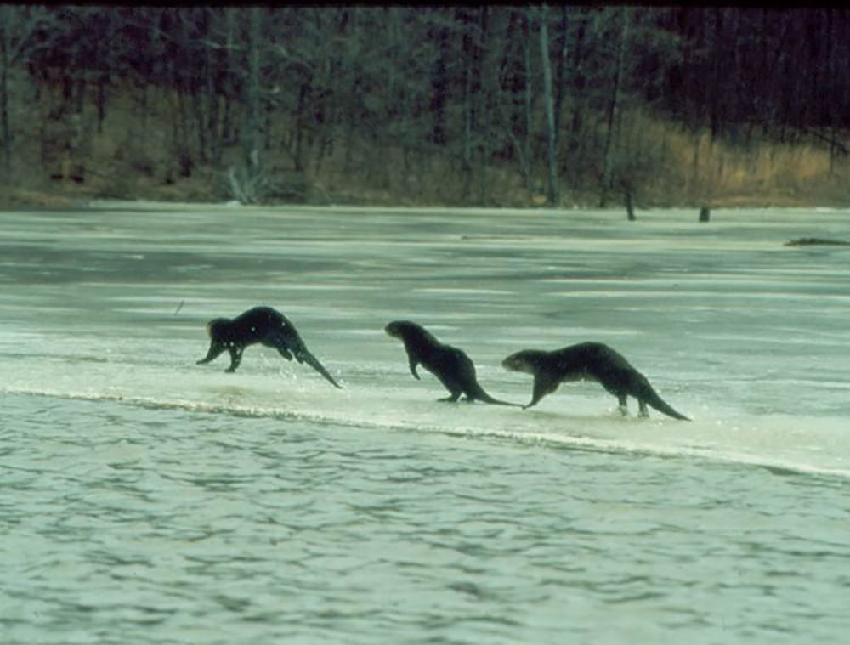

Slide 34



Application Case Studies
Course manager
Health record manager
Conference management system
(deployed!)
Jacqueline reduces the number of lines of policy code and has reasonable overheads!
Notes:
We’ve implemented the following small applications: a course manager, a health record manager, and a conference management system that we’ve used to run a workshop.
Our results suggest that Jacqueline reduces the number of lines of policy code and has reasonable overheads.
TRANSITION: Let’s see how it looks to change a policy in the conference management system.

Slide 35
Demo
Notes:
TRANSITION: It turns out that the system runs pretty well when we have more records too.

Slide 36
Conference Management System Running Times
Tests from Amazon AWS machine via HTTP requests from another machine.
*Different from numbers in paper.
Notes:
We compared some running times for our Jacqueline conference management system to a conference management system written in Django, with hand-implemented policies.
We ran these tests on an Amazon AWS machine by sending multiple HTTP requests from another machine and averaging over them.
Along the x axis we have increasing number of papers in the database and along the y access to have the time it takes to show pages.
First we compare the time it takes to show all the information for a single paper. The times for Jacqueline are better because the Django implementation requires multiple passes over some query results to apply policy checks.
We then compare the time it takes to show all papers. In this case, both implementations are resolving policy checks with database queries for each data item being shown. There is a 1.5x slowdown with Jacqueline, which is pretty reasonable.
TRANSITION: In summary, here’s why you should consider using the policy-agnostic approach.

Slide 37
Summary: Policy-Agnostic Web Programming with Jacqueline
1
Programmer specifies information flow policies separately from other functionality.
3
Enhanced runtime encompasses applications and databases, preventing leaks between the two.
Policy annotations
Sensitive data
Database
We have strong formal guarantees and evidence that this can be practical!
2
Runtime prevents information leaks according to policy annotations.
Notes:
In this talk, I describe the Jacqueline web framework, the double hull for database-backed web applications.
In Jacqueline, programmers provide policy annotations separately from the rest of the program. This is what we call a policy-agnostic programming model because the policies are factored out.
The runtime prevents information leaks according to policy annotations.
And the enhanced runtime encompasses both the application and the database, preventing leaks between the two. I’ll describe later in the talk why it’s especially important to enforce policies across these multiple runtimes.
TRANSITION: With this paper, we make the following contributions.

Slide 38

You can factor out information flow policies from other code to avoid policy spaghetti!
You can enforce policies across the application and database by using a carefully-crafted ORM!
You can build realistic systems using this approach!
http://jeeveslang.org
http://github.com/jeanqasaur/jeeves
Notes:
They want you to know that you can factor out information flow policies from other code to avoid policy spaghetto.
Finally, I’d like to say that it’s incredibly exciting that so many people are programming and that the concerns programmers have are far more varied than the ones people had when they first developed the languages we’re using. This, combined with advances in programming tools, means that now is a great time to rethink our programming models. I’m excited to see what we come up with.

